Slide 1
Natural Language Processing Explained for beginners
What is NLP?
Why it’s important ?
What are the tools for NLP?
Let’s dive in with hands-on in Python

Slide 2
Regular Expressions What and Why
What is it
A language to specify the rules for the set of possible strings that you want to search in a corpus of text.
Why
Why not using a python program for searching?
Why not string functions?
Can these find everything one wants?
Your password must have at least 8 characters, at least 1 upper case letter, at least 1 lowercase letter, at least 1 number and at least 1 symbol from the special symbols

Slide 3
Regular Expressions The ELIZA chatbot
User: I am unhappy.
ELIZA: DO YOU THINK COMING HERE WILL HELP YOU NOT TO BE UNHAPPY
User: I need some help, that much seems certain.
ELIZA: WHAT WOULD IT MEAN TO YOU IF YOU GOT SOME HELP
User: Perhaps I could learn to get along with my mother.
ELIZA: TELL ME MORE ABOUT YOUR FAMILY
User: My mother takes care of me.
ELIZA: WHO ELSE IN YOU FAMILY TAKES CARE OF YOU
User: My father.
ELIZA: YOUR FATHER
User: You are like my father in some ways.
Weizenbaum (1966)
ELIZA is a surprisingly simple
program that uses pattern matching to recognize phrases like “I need X” and translate
them into suitable outputs like “What would it mean to you if you got X?”.

Slide 4
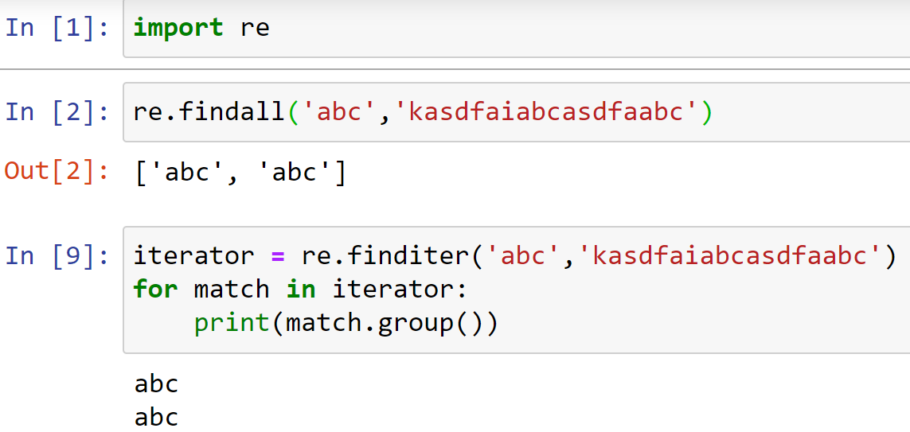
Regular Expressions How to…

Slide 5
Regular Expressions Meta characters
. ^ $ * + ? { } [ ] \ | ( )

Slide 6
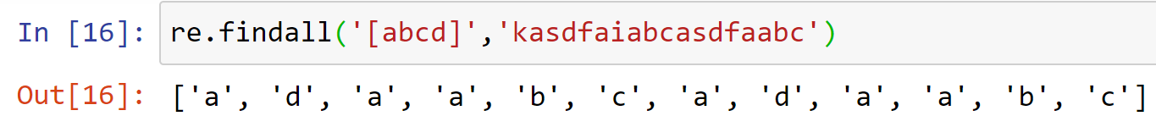
Regular Expressions Meta characters
[]
They’re used for specifying a character class, which is a set of characters that you wish to match. Characters can be listed individually like [abcdef], or a range of characters can be indicated by giving two characters and separating them by a ’-’like [a-f]

Slide 7
Regular Expressions Meta characters
[]
Exercise-1: Count the number of digits in a string.

Slide 8
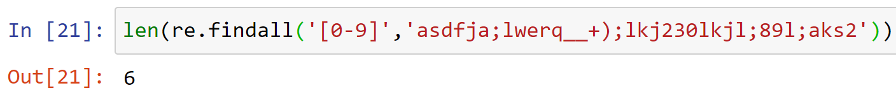
Regular Expressions Meta characters
[]
Solution-1: Count the number of digits in a string.

Slide 9
Regular Expressions Meta characters
[]
Exercise-2: Check if text contains any number with consecutive 4 digits

Slide 10
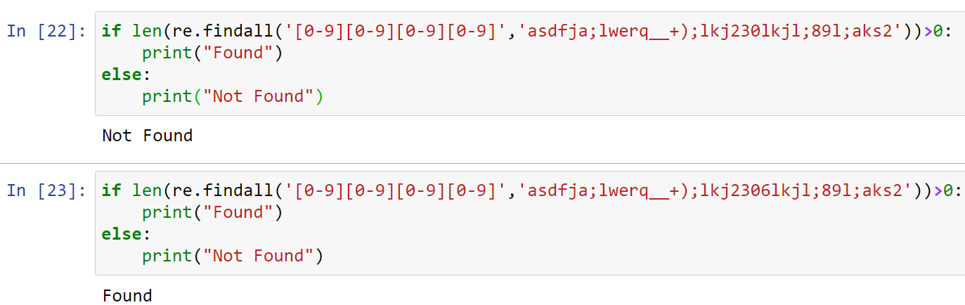
Regular Expressions Meta characters
[]
Solution-2: Check if text contains any number with consecutive 4 digits

Slide 11
Regular Expressions Meta characters
^
Set Complement: [^023abf] everything other than {0,2,3,a,b,f}
Position Matters: [023abf^] everything in {0,2,3,a,b,f,^}

Slide 12
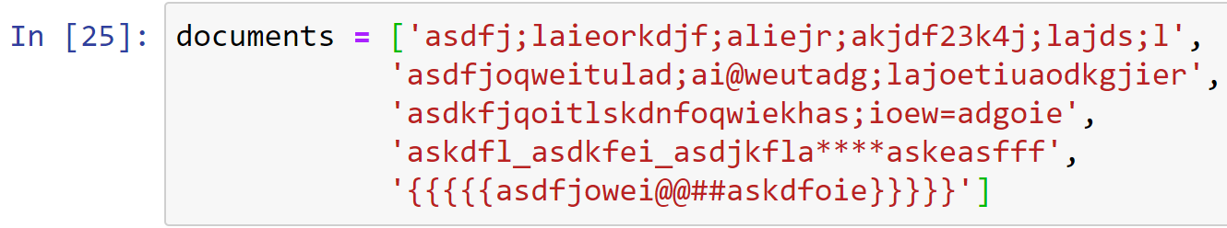
Regular Expressions Meta characters
^
Exercise-3: List the documents that does not contain any digit and any of the following characters: {:,”,{,},(,),@,#,&}

Slide 13
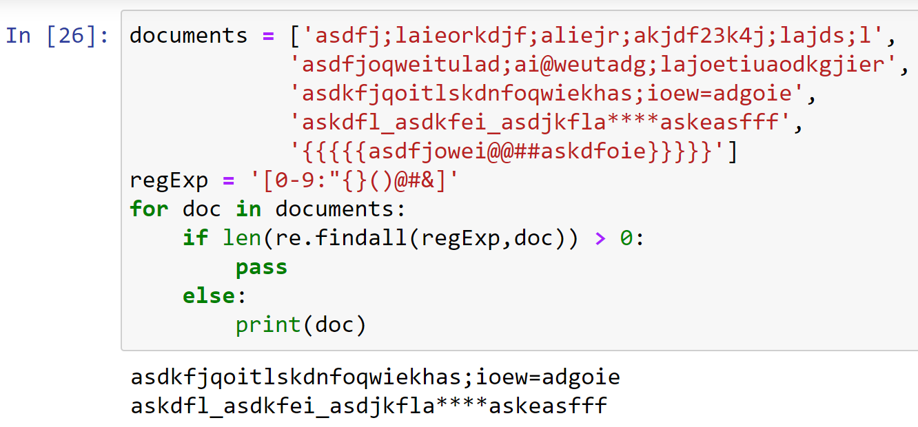
Regular Expressions Meta characters
^
Solution-3: List the documents that does not contain any digit and any of the following characters: {:,”,{,},(,),@,#,&}

Slide 14
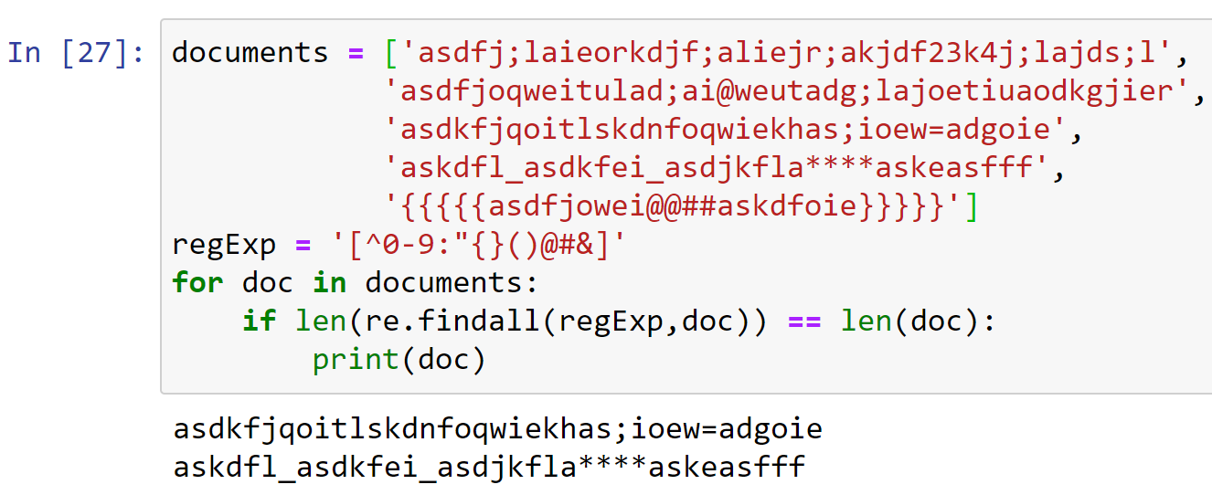
Regular Expressions Meta characters
^
Solution-3: List the documents that does not contain any digit and any of the following characters: {:,”,{,},(,),@,#,&}

Slide 15
Regular Expressions Meta characters
\
Exercise-4: Count all the backslashes in a document

Slide 16
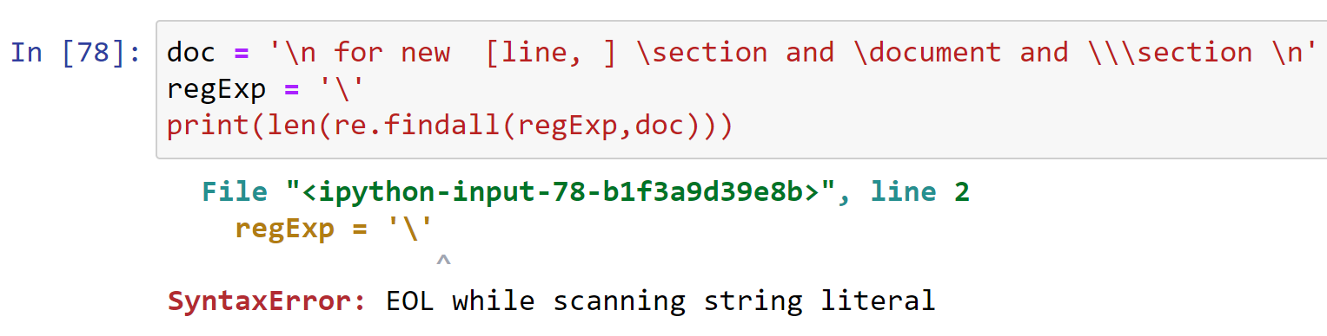
Regular Expressions Meta characters
\
First Attempt-4: Count all the backslashes in a document

Slide 17
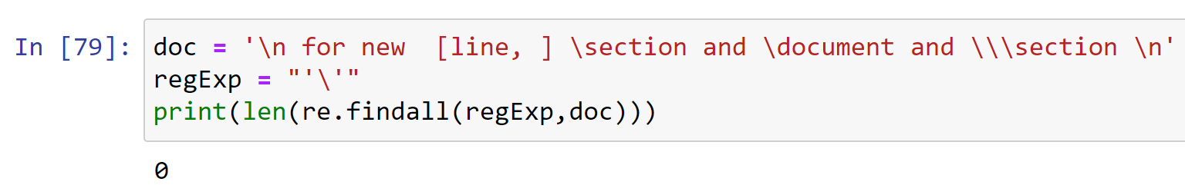
Regular Expressions Meta characters
\
Second Attempt-4: Count all the backslashes in a document

Slide 18
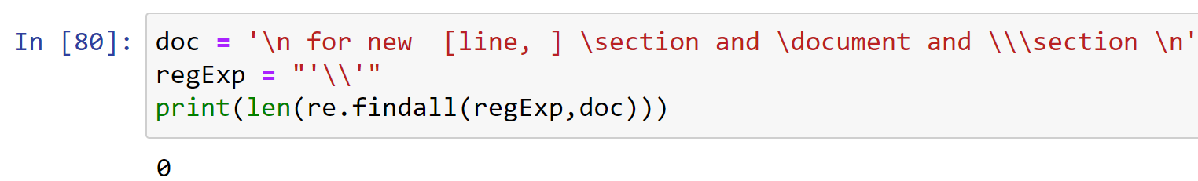
Regular Expressions Meta characters
\
Third Attempt-4: Count all the backslashes in a document

Slide 19
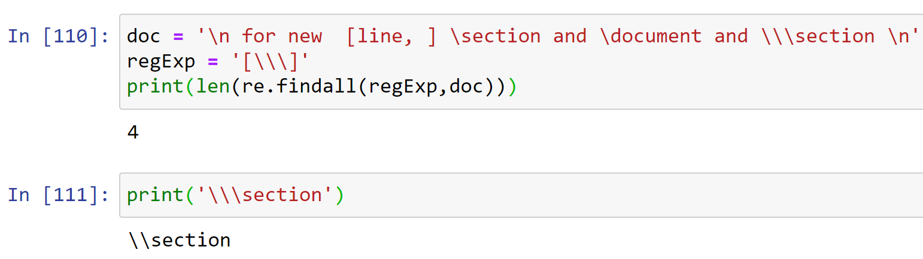
Regular Expressions Meta characters
\
Fourth Attempt-4: Count all the backslashes in a document

Slide 20
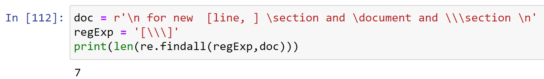
Regular Expressions Meta characters
\
Solution-4: Count all the backslashes in a document

Slide 21
Regular Expressions Meta characters
\
Exercise-5: Count all backslashes and brackets in a document

Slide 22
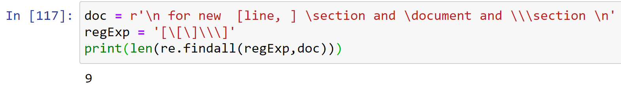
Regular Expressions Meta characters
\
Solution-5: Count all backslashes and brackets in a document

Slide 23
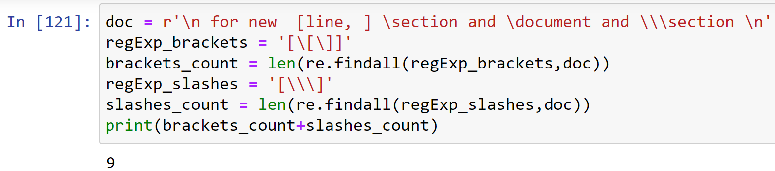
Regular Expressions Meta characters
\
Solution-5: Count all backslashes and brackets in a document

Slide 24
Regular Expressions Meta characters
\
Exercise-6: Count all \section in a latex document below

Slide 25
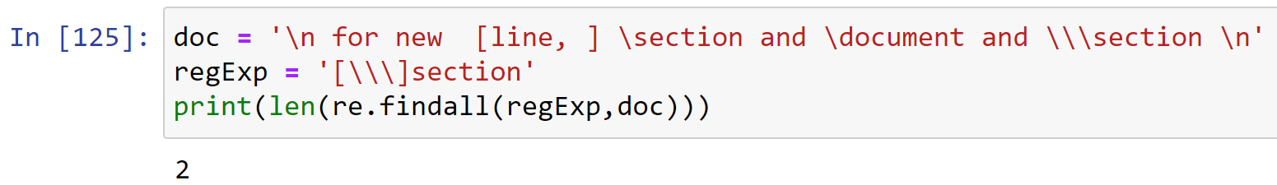
Regular Expressions Meta characters
\
Solution-6: Count all \section in a latex document below

Slide 26
Regular Expressions Meta characters
\
\d Matches any decimal digit; this is equivalent to the class [0-9].
\D Matches any non-digit character; this is equivalent to the class [^0-9].
\s Matches any whitespace character; this is equivalent to the class [ \t\n\r\f\v].
\S Matches any non-whitespace character; this is equivalent to the class [^ \t\n\r\f\v].
\w Matches any alphanumeric character; this is equivalent to the class [a-zA-Z0-9_].
\W Matches any non-alphanumeric character; this is equivalent to the class [^a-zA-Z0-9_].
These sequences can be included inside a character class.

Slide 27
Regular Expressions Meta characters
\
Exercise-7: Count the number of spaces, digits and underscores in a document

Slide 28
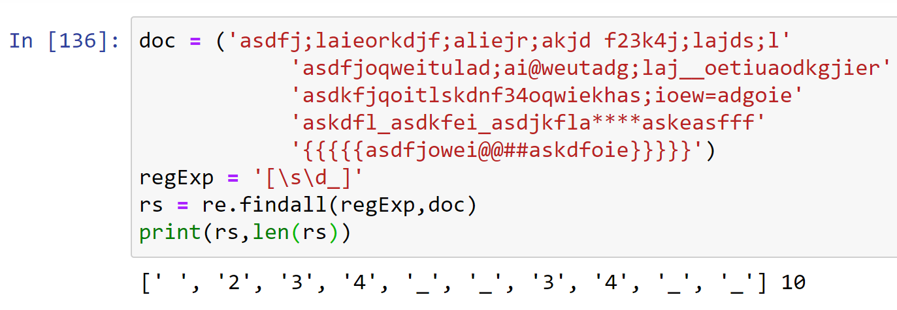
Regular Expressions Meta characters
\
Solution-7: Count the number of spaces, digits and underscores in a document

Slide 29
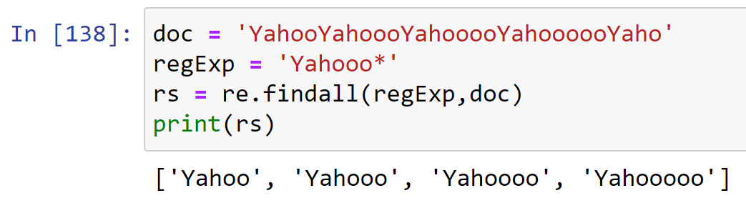
Regular Expressions Meta characters
*
Find repeated pattern, from zero to possibly infinite times.
Yahoo, Yahooo, Yahoooo, Yahoooo…

Slide 30
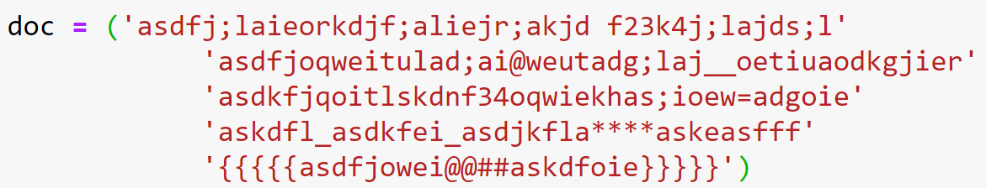
Regular Expressions Meta characters
*
Exercise-8: Given a document, list all the longest possible substrings that are proper variable names in most of the programming languages. A proper variable name is defined as the one that does not start with a digit and does not contain any special character other than under score, and it can have arbitrary number of characters.

Slide 31
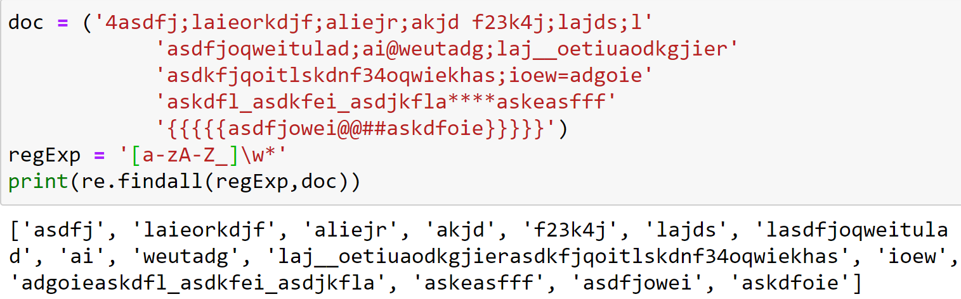
Regular Expressions Meta characters
*
Solution-8: Given a document, list all the longest possible substrings that are proper variable names in most of the programming languages. A proper variable name is defined as the one that does not start with a digit and does not contain any special character other than under score, and it can have arbitrary number of characters.

Slide 32
Regular Expressions Meta characters
*
Home Work-1: Given a list of variables and function names of a program, find out if all the variable names and function names are valid or not. If any of the variable or function name is invalid, print “syntax error” otherwise print “OK”. The validity criteria of a variable name and function name is the same as in Exercise-8 of this module.

Slide 33
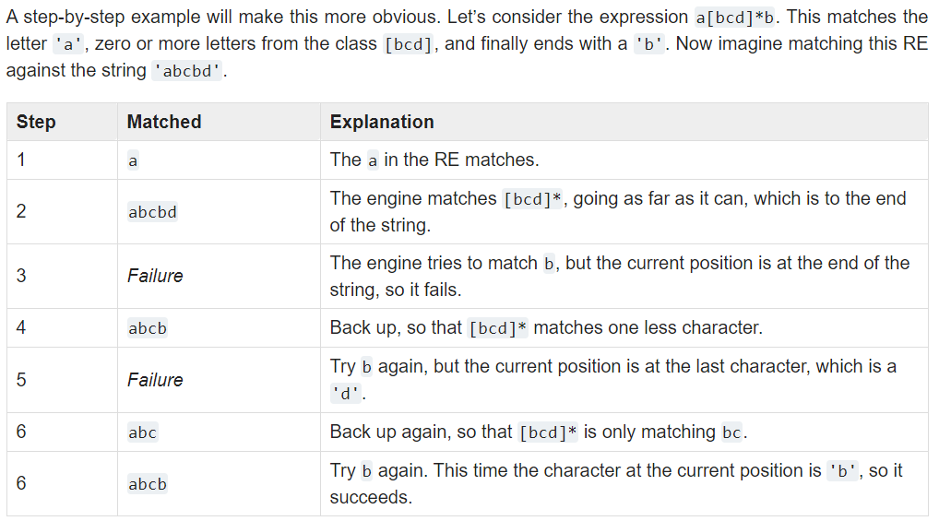
Regular Expressions Meta characters
*
Greedy matching:
https://docs.python.org/3/howto/regex.html

Slide 34
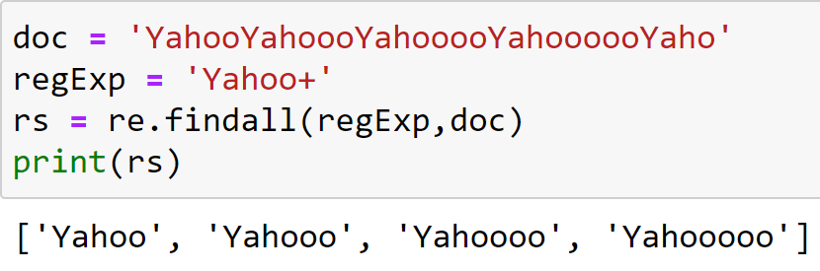
Regular Expressions Meta characters
+
Find repeated pattern, from one to possibly infinite times.
Yahoo, Yahooo, Yahoooo, Yahoooo…

Slide 35
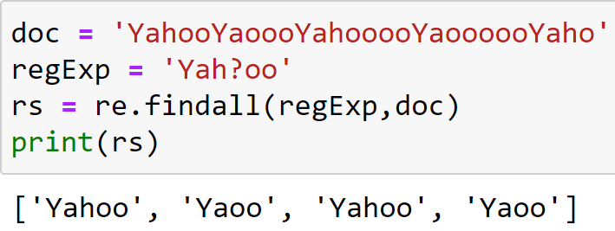
Regular Expressions Meta characters
?
Find repeated pattern, from zero to possibly 1 times.
Yaoo, Yahoo

Slide 36
Regular Expressions Meta characters
{m,n}
Find repeated pattern, from m to possibly n times.

Slide 37
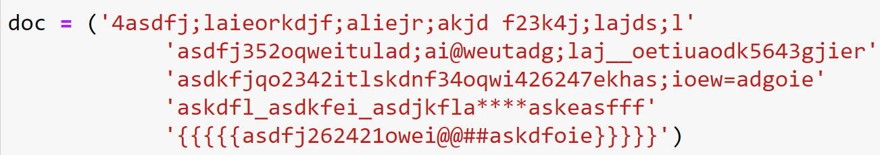
Regular Expressions Meta characters
{m,n}
Exercise-9: List all the substrings in a document that contain at least 2 digits and at most 5 digits.

Slide 38
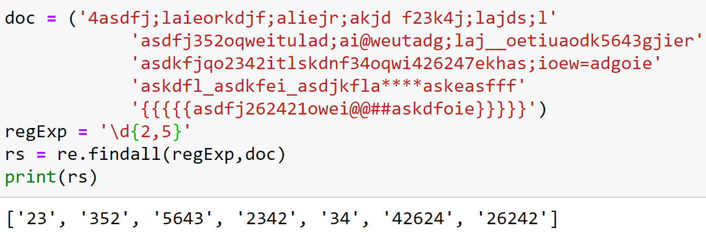
Regular Expressions Meta characters
{m,n}
Solution-9: List all the substrings in a document that contain at least 2 digits and at most 5 digits.

Slide 39
Regular Expressions Meta characters
You can omit either m or n; in that case, a reasonable value is assumed for the missing value. Omitting m is interpreted as a lower limit of 0, while omitting n results in an upper bound of infinity.
{m,n}
So, {0,} is the same as *, {1,} is equivalent to +, and {0,1} is the same as ?.

Slide 40
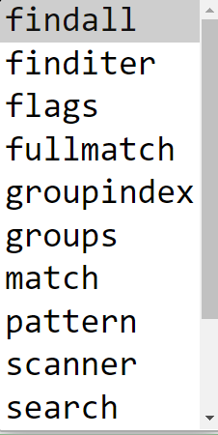
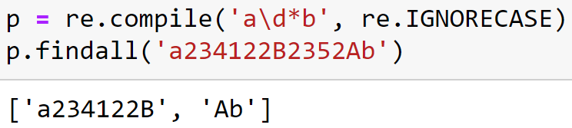
Regular Expressions Pattern Objects
Regular expressions can be compiled into pattern objects, which have methods for various operations such as searching for pattern matches or performing string substitutions.

Slide 41
Regular Expressions match and search
Exercise-10: Given a document, count the number of space characters, if any, in the beginning of the document.

Slide 42
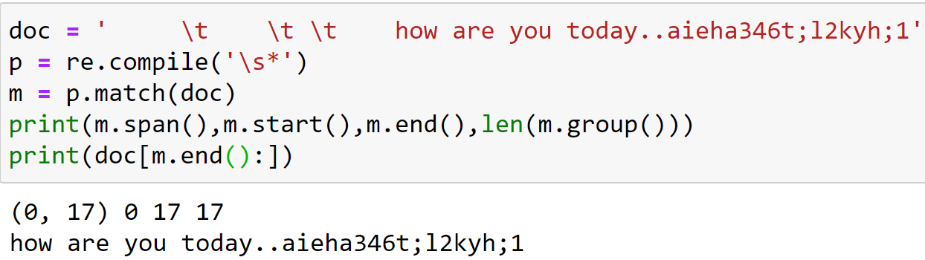
Regular Expressions match and search
Solution-10: Given a document, count the number of space characters, if any, in the beginning of the document.

Slide 43
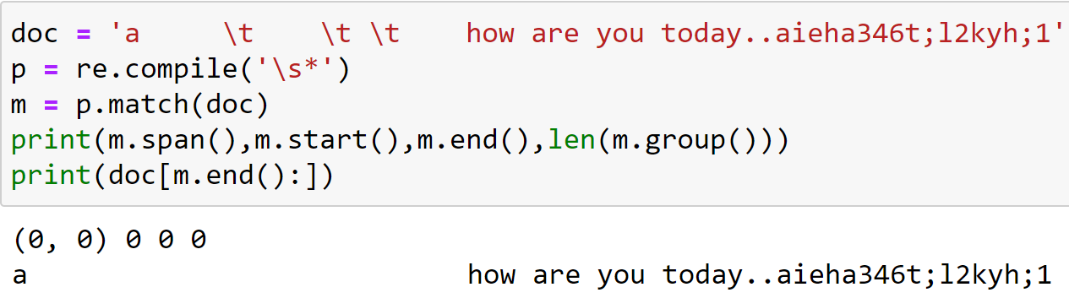
Regular Expressions match and search
Solution-10: Given a document, count the number of space characters, if any, in the beginning of the document.

Slide 44
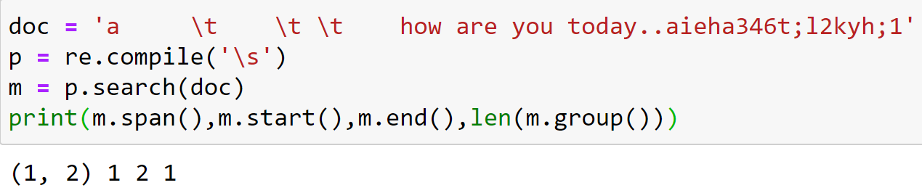
Regular Expressions match vs search

Slide 45
Regular Expressions finditer
Exercise-11: List the locations where valid variables in a document exist. The definition of a valid variable is the same as it is in exercise 8 of this module.

Slide 46
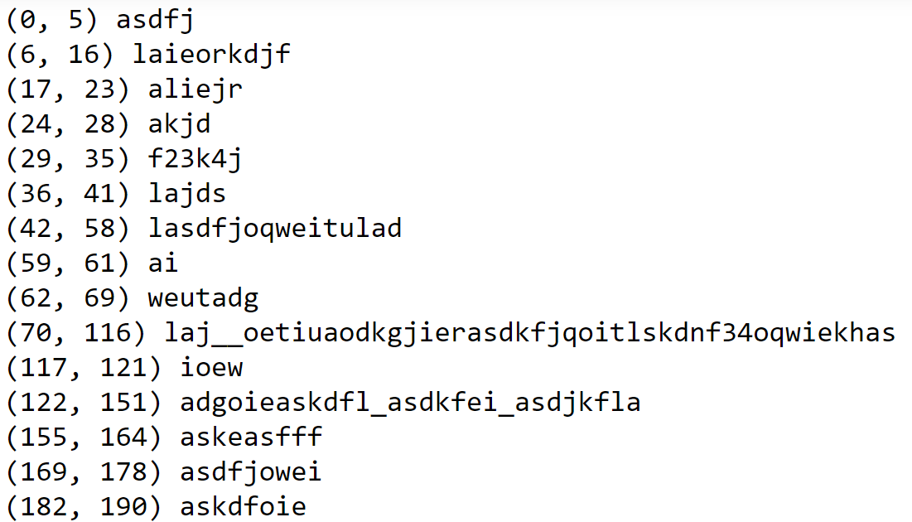
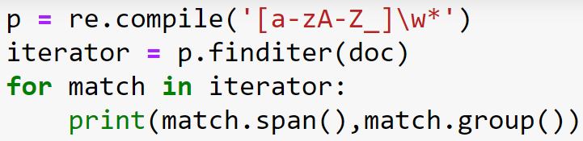
Regular Expressions finditer
Solution-11: List the locations where valid variables in a document exist. The definition of a valid variable is the same as it is in exercise 8 of this module.

Slide 47
Regular Expressions Meta characters
|
Logical or…

Slide 48
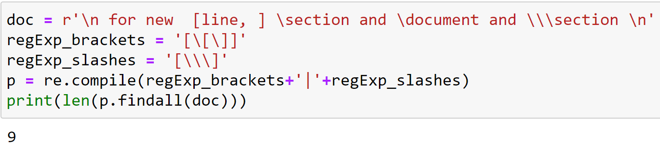
Regular Expressions Meta characters
|
Logical or…
Revisited: Exercise-5: Count all backslashes and brackets in a document

Slide 49
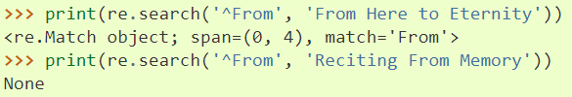
Regular Expressions Meta characters
^
If not in class, it can be used for matching at the beginning

Slide 50
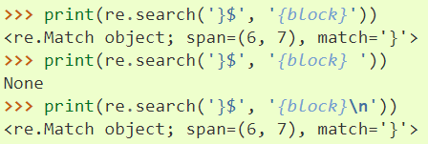
Regular Expressions Meta characters
$
Matches at the end of a line, which is defined as either the end of the string, or any location followed by a newline character

Slide 51
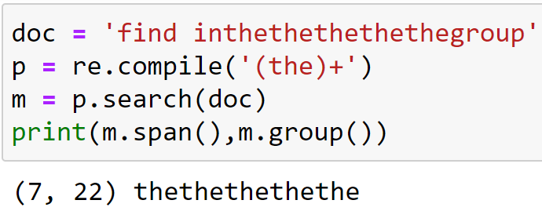
Regular Expressions Meta characters
()
Makes a group of characters to be treated just like a single character

Slide 52
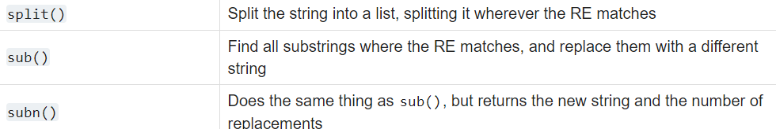
Regular Expressions String modification

Slide 53
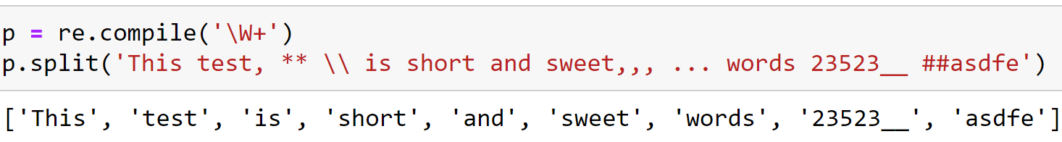
Regular Expressions a simple word tokenizer using split

Slide 54
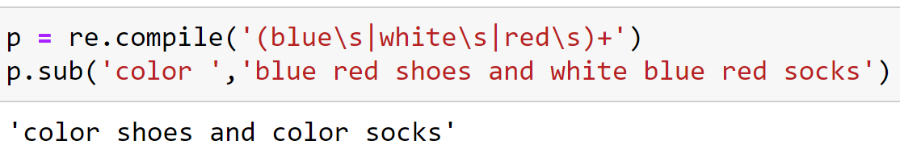
Regular Expressions sub

Slide 55
Regular Expressions sub
Exercise-12: In a document, replace multiple consecutive white spaces into a single one and remove white spaces at the beginning and at the end of the document.

Slide 56
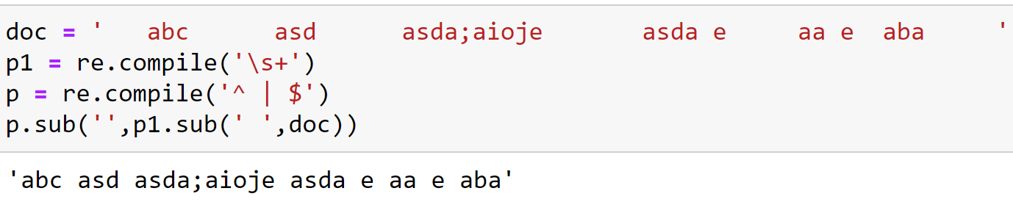
Regular Expressions sub
Solution-12: In a document, replace multiple consecutive white spaces into a single one and remove white spaces at the beginning and at the end of the document.

Slide 57
Text Processing Word
Before we talk about processing words, we need to decide what counts as a word.
“I always uh do the main um processing, I mean, the uh um data-processing.”

Slide 58
Text Processing Vocabulary
Set of unique words (word types)
“I always uh do the main um processing, I mean, the uh um data-processing.”

Slide 59
Text Processing Tokens
List of words (tokens) in a document
“I always uh do the main um processing, I mean, the uh um data-processing.”

Slide 60
Text Processing spaCy
Lets see it running in python
“I always uh do the main um processing, I mean, the uh um data-processing.”

Slide 61
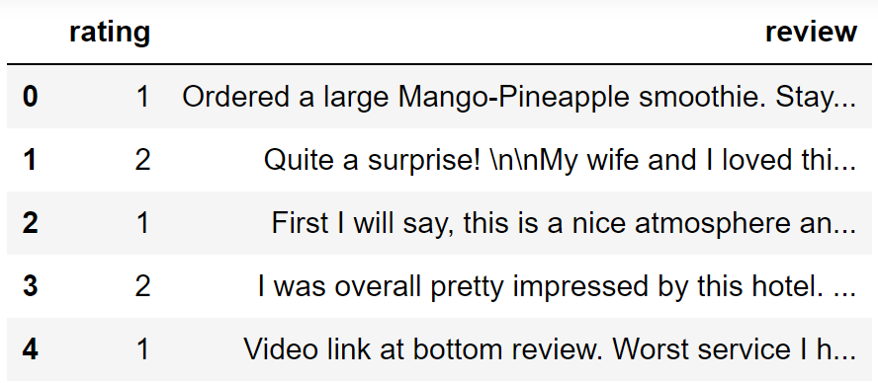
Text Processing Data Cleaning and preparation for classification
Yelp Reviews
Binary Classification

Slide 62
Text Processing One Hot Encoding

Slide 63
Text Processing Encoding documents

Slide 64
Text Processing Text Normalization
Every NLP task requires text normalization:
Tokenizing words
Normalizing word formats
Segmenting sentences

Slide 65
Text Processing Space based Tokenization
Can't just blindly remove punctuation:
m.p.h., Ph.D., AT&T, cap’n
prices ($45.55)
dates (01/02/06)
URLs (http://www.aisciences.net)
hashtags (#nlp)
email addresses (someone@somewhere.com)
Clitic: a word that doesn't stand on its own
"are" in we're, French "je" in j'ai, "le" in l'honneur
When should multiword expressions (MWE) be words?
New York, rock ’n’ roll

Slide 66
Text Processing Space based Tokenization
Many languages (like Chinese, Japanese, Thai) don't use spaces to separate words!
How do we decide where the token boundaries should be?

Slide 67
Text Processing Data Driven approach
Instead of
white-space segmentation
single-character segmentation
Use the data to tell us how to tokenize.
Subword tokenization (because tokens can be parts of words as well as whole words)

Slide 68
Text Processing Byte Pair Encoding (BPE)
Let vocabulary be the set of all individual characters
= {A, B, C, D,…, a, b, c, d….}
Repeat:
Choose the two symbols that are most frequently adjacent in the training corpus (say 'A', 'B')
Add a new merged symbol 'AB' to the vocabulary
Replace every adjacent 'A' 'B' in the corpus with 'AB'.
Until k merges have been done.

Slide 69
Text Processing Byte Pair Encoding (BPE)
Corpus:
low low low low low lowest lowest newer newer newer newer newer newer wider wider wider new new

Slide 70
Text Processing Byte Pair Encoding (BPE)
Corpus:
low low low low low lowest lowest newer newer newer newer newer newer wider wider wider new new

Slide 71
Text Processing Byte Pair Encoding (BPE)
Corpus:
low low low low low lowest lowest newer newer newer newer newer newer wider wider wider new new

Slide 72
Text Processing Byte Pair Encoding (BPE)
Corpus:
low low low low low lowest lowest newer newer newer newer newer newer wider wider wider new new
On the test data, run each merge learned from the training data:
Greedily
In the order we learned them
(test frequencies don't play a role)
So: merge every e r to er, then merge er _ to er_, etc.
Result:
Test set "n e w e r _" would be tokenized as a full word
Test set "l o w e r _" would be two tokens: "low er_"

Slide 73
Text Processing Byte Pair Encoding (BPE)
Usually include frequent words
And frequent subwords
Which are often morphemes like -est or –er
A morpheme is the smallest meaning-bearing unit of a language
unlikeliest has 3 morphemes un-, likely, and -est

Slide 74
Text Processing Byte Pair Encoding (BPE) Implementation
Let’s Implement BPE!

Slide 75
Text Processing Word Normalization
Putting words/tokens in a standard format
U.S.A. or USA
uhhuh or uh-huh
Fed or fed
am, is, be, are

Slide 76
Text Processing Case folding
Case is helpful (US versus us is important)

Slide 77
Text Processing Lemmatization
Represent all words as their lemma, their shared root
am, are, is → be
car, cars, car's, cars' → car
He is reading detective stories → He be read detective story

Slide 78
Text Processing Stemming
Morphemes:
The small meaningful units that make up words
Stems: The core meaning-bearing units
Affixes: Parts that adhere to stems, often with grammatical functions

Slide 79
Text Processing Sentence Segmentation
!, ? mostly unambiguous but period “.” is very ambiguous
Sentence boundary
Abbreviations like Inc. or Dr.
Numbers like .02% or 4.3
Common algorithm: Tokenize first: use rules or ML to classify a period as either (a) part of the word or (b) a sentence-boundary.
An abbreviation dictionary can help
Sentence segmentation can then often be done by rules based on this tokenization.

Slide 80
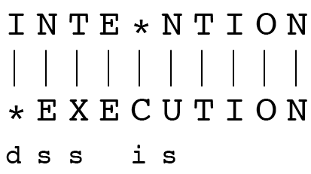
Text Processing Spelling Correction (Minimum Edit Distance)
If each operation has cost of 1
Distance between these is 5
If substitutions cost 2 (Levenshtein)
Distance between them is 8

Slide 81
Text Processing Spelling Correction (Minimum Edit Distance)
N | 9
O | 8
I | 7
T | 6
N | 5
E | 4
T | 3
N | 2
I | 1
# | 0 | 1 | 2 | 3 | 4 | 5 | 6 | 7 | 8 | 9
 | # | E | X | E | C | U | T | I | O | N

Slide 82
Text Processing Spelling Correction (Minimum Edit Distance)
N | 9
O | 8
I | 7
T | 6
N | 5
E | 4
T | 3
N | 2
I | 1
# | 0 | 1 | 2 | 3 | 4 | 5 | 6 | 7 | 8 | 9
 | # | E | X | E | C | U | T | I | O | N

Slide 83
Text Processing Spelling Correction (Minimum Edit Distance)
N | 9 | 8 | 9 | 10 | 11 | 12 | 11 | 10 | 9 | 8
O | 8 | 7 | 8 | 9 | 10 | 11 | 10 | 9 | 8 | 9
I | 7 | 6 | 7 | 8 | 9 | 10 | 9 | 8 | 9 | 10
T | 6 | 5 | 6 | 7 | 8 | 9 | 8 | 9 | 10 | 11
N | 5 | 4 | 5 | 6 | 7 | 8 | 9 | 10 | 11 | 10
E | 4 | 3 | 4 | 5 | 6 | 7 | 8 | 9 | 10 | 9
T | 3 | 4 | 5 | 6 | 7 | 8 | 7 | 8 | 9 | 8
N | 2 | 3 | 4 | 5 | 6 | 7 | 8 | 7 | 8 | 7
I | 1 | 2 | 3 | 4 | 5 | 6 | 7 | 6 | 7 | 8
# | 0 | 1 | 2 | 3 | 4 | 5 | 6 | 7 | 8 | 9
 | # | E | X | E | C | U | T | I | O | N

Slide 84
Text Processing Spelling Correction (Minimum Edit Distance)

Slide 85
Text Processing Spelling Correction (Minimum Edit Distance)
N | 9
O | 8
I | 7
T | 6
N | 5
E | 4
T | 3
N | 2
I | 1
# | 0 | 1 | 2 | 3 | 4 | 5 | 6 | 7 | 8 | 9
 | # | E | X | E | C | U | T | I | O | N
Initialization
D(i,0) = i
D(0,j) = j
Recurrence Relation:
For each i = 1…M
For each j = 1…N
D(i-1,j) + 1
D(i,j)= min D(i,j-1) + 1
D(i-1,j-1) + 2; if X(i) ≠ Y(j)
0; if X(i) = Y(j)
Termination:
D(N,M) is distance

Slide 86
Text Processing Minimum Edit Distance (MED) Implementation
Let’s Implement MED!

Slide 87
Language Modelling Probabilistic model: probability of a sentence
Machine Translation: P(high winds tonight) > P(large winds tonight)
Spelling Correction: P(about fifteen minutes from) > P(about fifteen minuets from)
Speech Recognition: P(I saw a van) >> P(eyes awe of an)

Slide 88
Language Modelling Language Model definition
Probability of a sentence: P(w₁,w₂,w₃,w₄,w₅…w_{n})
Probability of a next word: P(w_{n}|w₁,w₂…w_{n-1})

Slide 89
Language Modelling How to compute probabilities?
P(x₁,x₂,x₃,…,x_{n}) = P(x₁)P(x₂|x₁)P(x₃|x₁,x₂)…P(x_{n}|x₁,…,x_{n-1})

Slide 90
Website : www.aisciences.io

